Slide 1
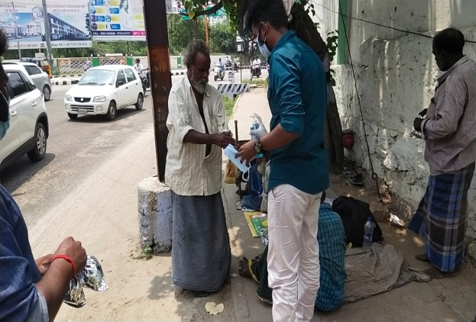
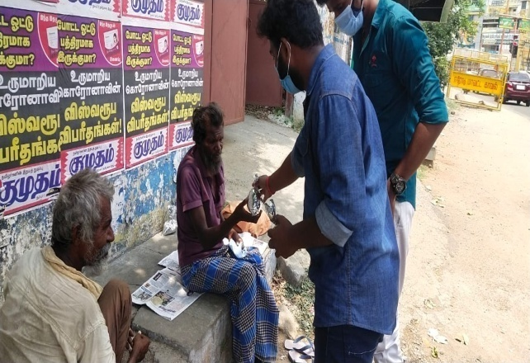
KONGU ARTS AND SCIENCE COLLEGE (AUTONOMOUS),
ERODE – 638 107
Youth Red Cross
Distribution of Face Mask and Food
Youth Red Cross volunteers distributed Face Mask and Food for needy people in erode district at the pandemic situation
The objective of this Program Wearing face masks is recommended as part of personal protective equipment and as a public health measure to prevent the spread of corona virus disease.
Youth Red Cross Volunteers came forward and provided face mask and food distribution during lockdown, totally 2 students were participated on 01.05.2021.
.

