Slide 1
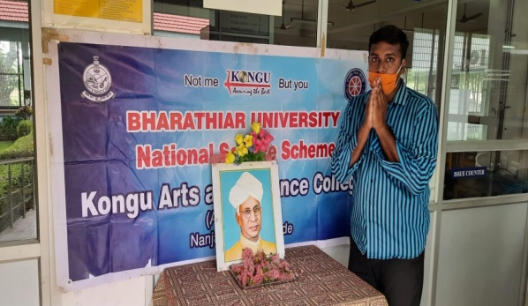
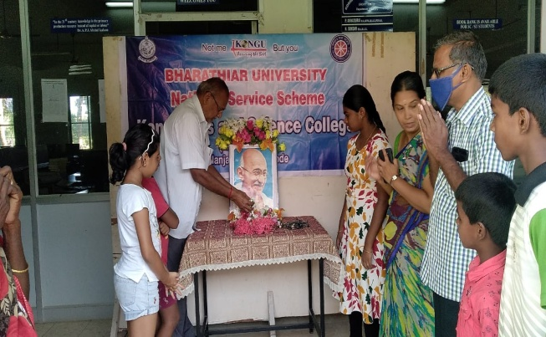
Name of the Event \ Title | Teachers Day Celebrations
Date of the Event | 05.09.2020
Gandhi Jayanthi Celebration
02.10.2020

Slide 2
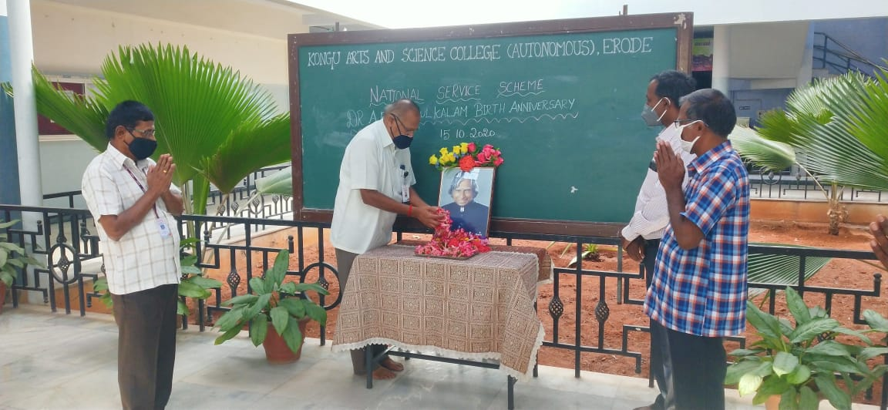
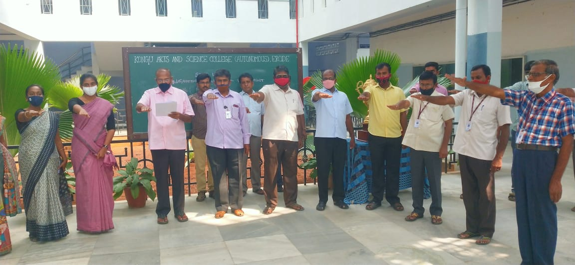
Dr.A.P.J Abdul Kalam Birth Anniversary Celebration
15.10.2020
Vigilance Awareness Week pledge
28.10.2020

Slide 3
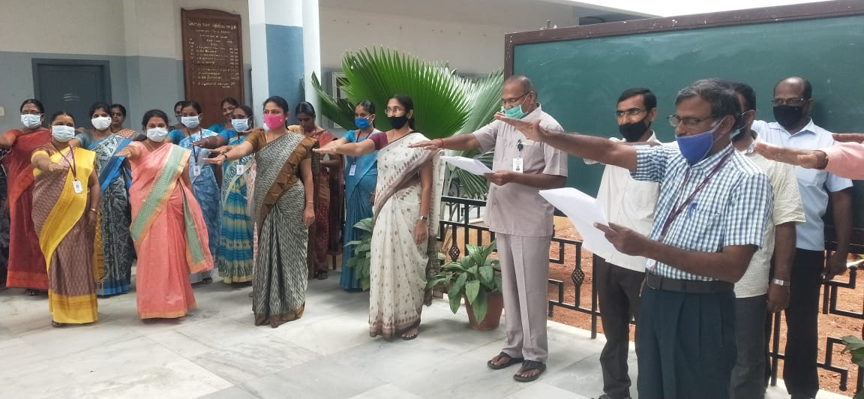
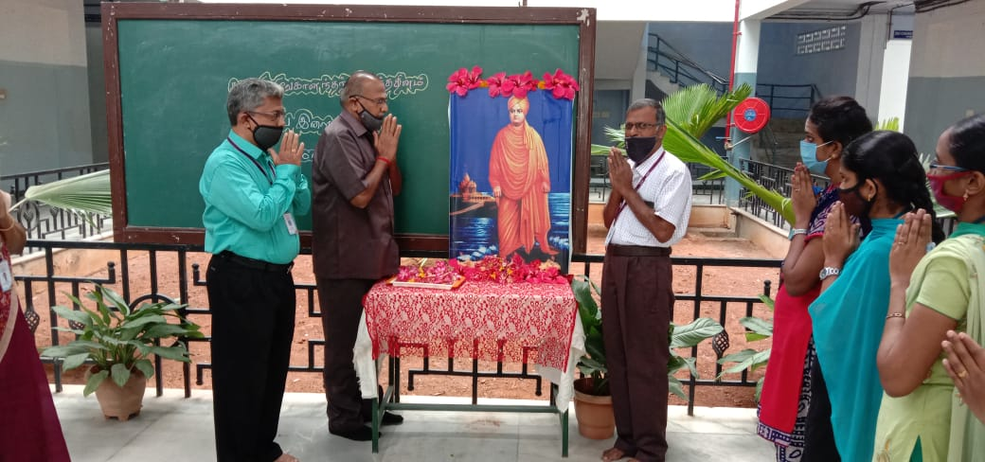
Constitution Daypledge was taken
26.11.2020
Swami VivekanandarBirth Anniversary Celebration
12.01.2021

Slide 4
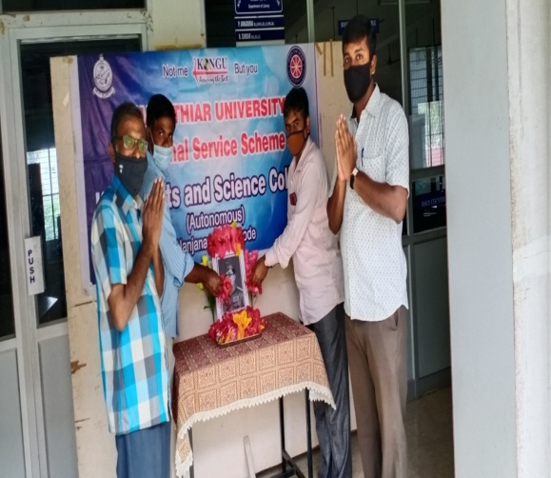
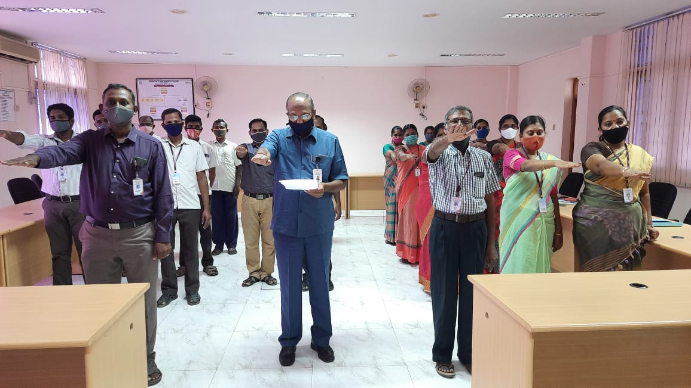
NethajiSubashChandra BoseBirth Anniversary Celebration
23.01.2021
National Voters Day pledge was taken
25.01.2021

Slide 5
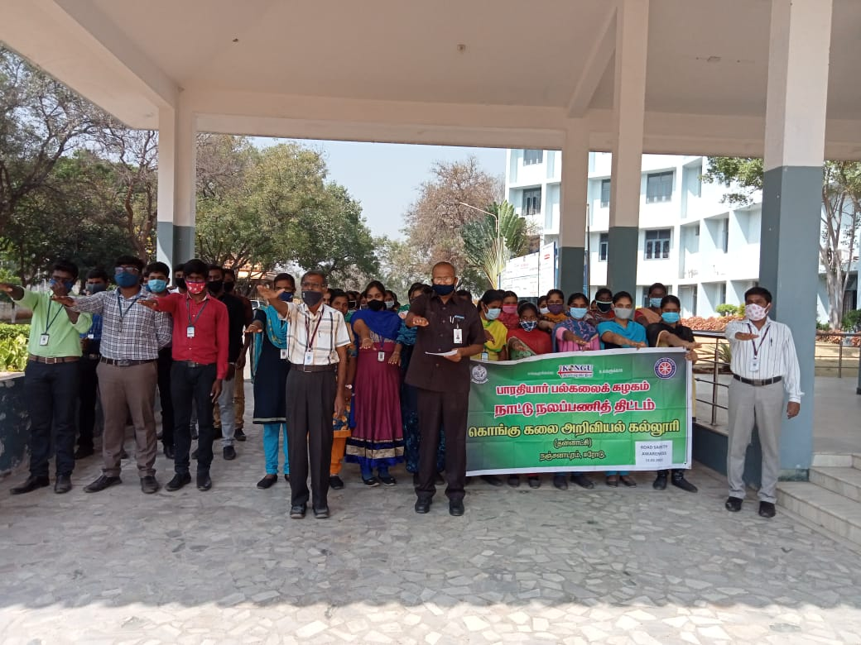
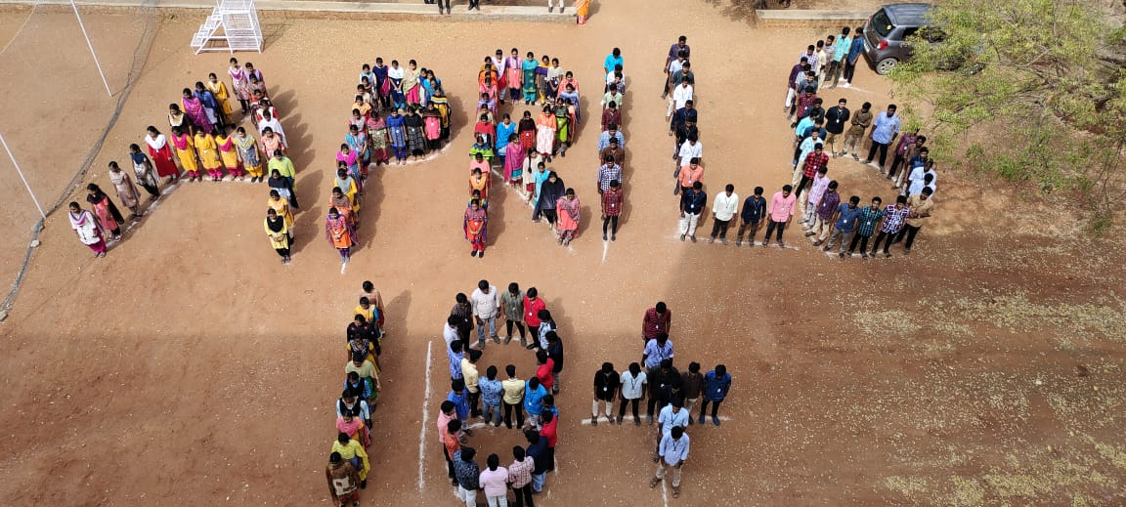
Road Safety Awareness Pledge
11.02.2021
Voters Awareness Pledge and Signature Campaign
12.03.2021

